Slide 1


CAPSTONE PROJECT
Azure Cloud FinOps & AI Workload Optimization Dashboard
Presented By
Student Name: Shoaib Akhtar Shaikh
College Name: ARMIET COLLEGE
Department: CSE (AIML)
Email ID: SHoneonaib7858@gmail.com

Slide 2
OUTLINE:
Problem Statement
Proposed System/Solution
System Approach
Algorithm & Deployment
Results
Conclusion
Future Scope
References

Slide 3
Problem Statement:
Cloud computing costs frequently spiral out of control in enterprise environments, particularly when deploying heavy, resource-intensive AI workloads like LLM training and predictive analytics.
Engineering and management teams struggle to identify "Zombie Servers"—virtual machines that consume a large portion of the financial budget but operate at extremely low CPU utilization.
A major operational concern is the lack of real-time visibility into wasted spend and the inability to quickly identify idle server hours to enforce automated cost-saving measures.

Slide 4
Proposed system/solution:
The proposed system is an enterprise-grade Azure Cloud FinOps dashboard built to actively monitor, trace, and optimize cloud infrastructure spend.
Data Pipeline: Ingest and transform raw server telemetry (timestamps, CPU usage, execution time) into actionable financial metrics.
Analytics Engine: Calculate exact wasted spend thresholds by decomposing generic tasks into specific Azure hardware costs (e.g., NC A100 GPUs vs. B-Series).
Actionable UI: Provide a dynamic diagnostic simulator and an Automation Heatmap to visually expose idle hours for safe server shutdowns.

Slide 5
System Approach:
System Requirements: Power BI Desktop for data modeling, visualization, and DAX metric calculation.
Data Engineering Strategy: Utilized Power Query M language to clean data, split datetimes for chronological accuracy, and implement conditional logic to assign Microsoft hardware pricing.
Enterprise Architecture: Implementation of a highly optimized Star Schema, connecting a central Fact_Telemetry table to distinct Dimension tables (Dim_Date, Dim_Workload, Dim_Hardware).

Slide 6
Algorithm and deployment:
Algorithm Selection: Utilized Power BI's native Exponential Smoothing algorithm for 30-day spend forecasting. Additionally, implemented DAX-based dynamic thresholding parameters to detect Zombie Servers.
Data Input: Historical server telemetry data containing execution times, workload priorities, and CPU usage percentages.
Prediction Process: A 'What-If' parameter allows stakeholders to dynamically adjust the minimum CPU efficiency threshold (e.g., changing from 15% to 20%) to instantly simulate potential cost savings in real-time.

Slide 7
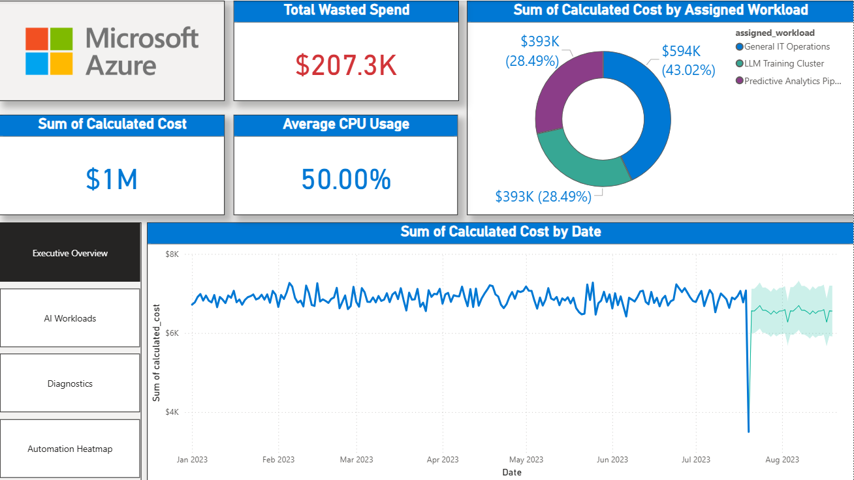
Results:
Page 1: Executive Overview

Slide 8
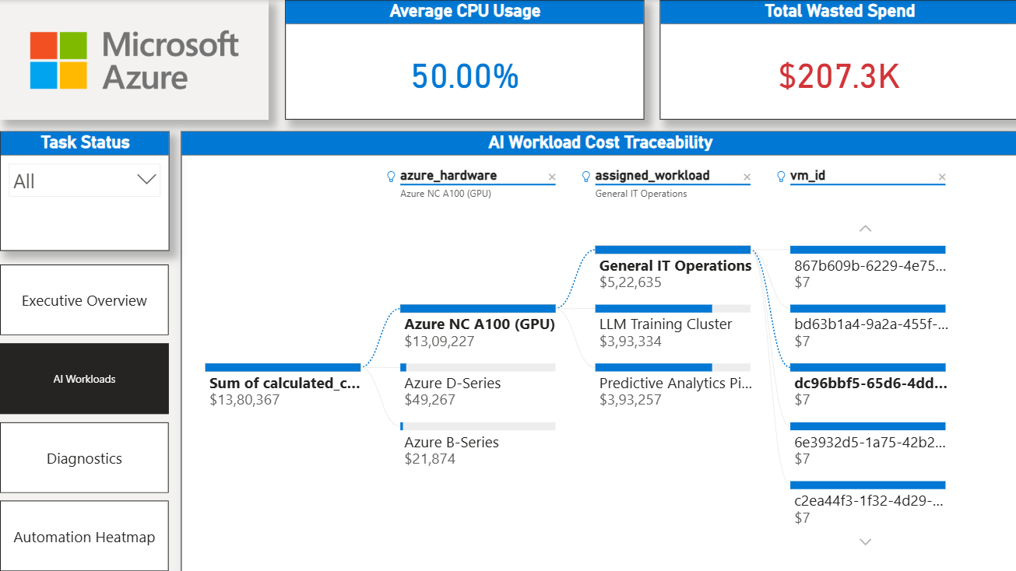
Results:
Page 2: AI Workloads

Slide 9
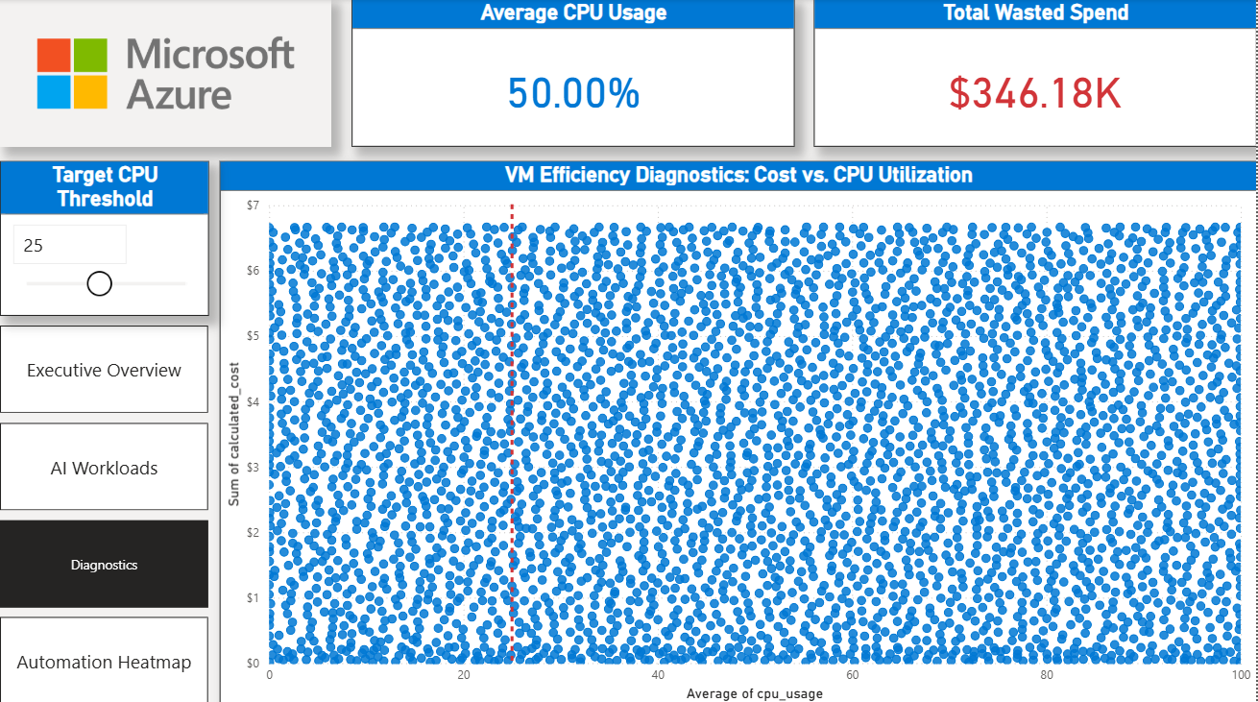
Results:
Page 3: Diagnostics

Slide 10
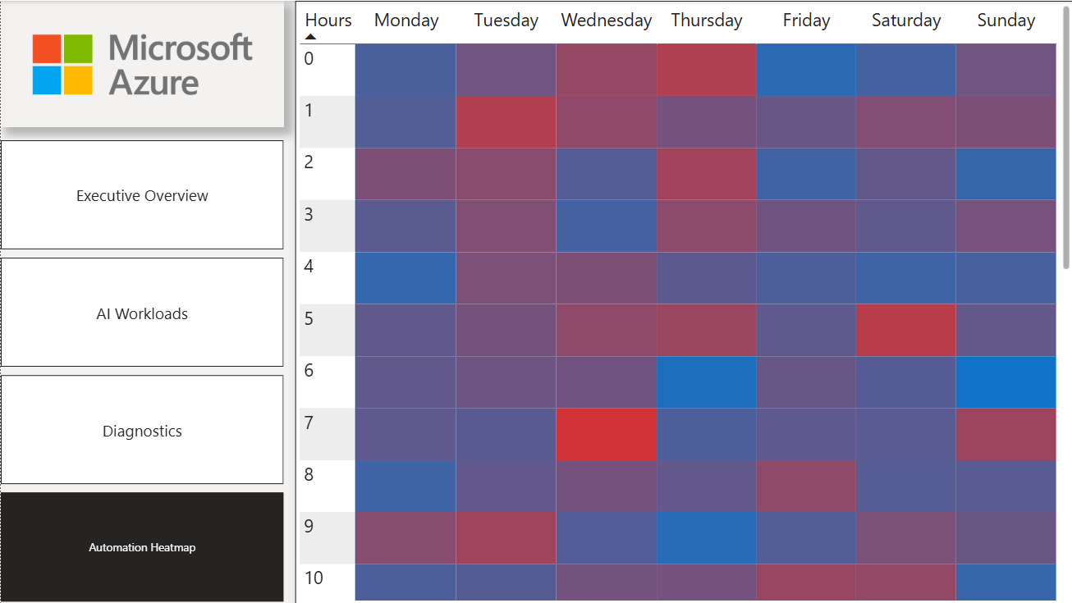
Results:
Page 4: Automation Heatmap

Slide 11
Conclusion:
The dashboard effectively bridges the gap between cloud engineering and finance teams by providing granular, undeniable visibility into AI workload costs. It enables proactive financial operations by highlighting inefficiencies and providing actionable data formats (like the Heatmap) for writing automated server shutdown scripts. Demonstrates the critical importance of aligning technical server telemetry with business finance to ensure sustainable enterprise AI deployment.

Slide 12
Future scope:
Integration with live Azure billing APIs to stream real-time telemetry into the dashboard rather than relying on static analytical datasets. Implementing automated, proactive alert systems to immediately notify engineering teams when a server drops below the efficiency threshold for a sustained period. Expanding the Decomposition Tree to track costs across multi-cloud environments (AWS and GCP) alongside Azure.

Slide 13
References:
Microsoft Learn Documentation: Power BI Data Modeling, Star Schema Architecture, and DAX Reference.
FinOps Foundation: Cloud Financial Management Frameworks and Best Practices.
GitHub Link: https://github.com/Shoaib5553/Azure-Cloud-FinOps-AI-Workload-Optimization-Dashboard.git

Slide 14
Thank You

